Slide 1
Chapter 2
Software Concepts

Slide 2
Hardware and Software
A computer consists of both hardware and software and both are equally important for the working of the computer system.
The electronic components of a computer system that we can see and touch are called hardware.
Software is a general term used for computer programs that control the operations of the computer.
A program is a sequence of instructions that perform a particular task. A set of programs form a software.

Slide 3
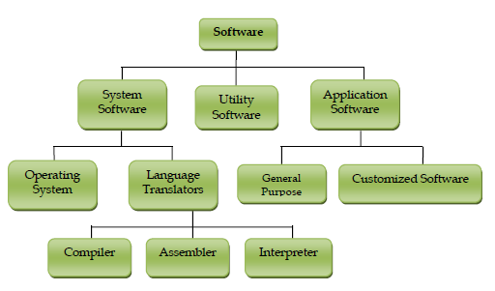
Types of Software
Software can be broadly are categorized as
System Software
Application Software
Utility Software

Slide 4
System Software
System Software is directly related to coordinating computer operations and performs tasks associated with controlling and utilizing computer hardware.
These programs assist in running application programs and are designed to control the operation of a computer system.
System software directs the computer what to do, when to do and how to do.
System software can be further categorized into
Operating System
Language Translators

Slide 5
Operating System
An Operating system is the most important system software.
It is a set of programs that control and supervise the hardware of a computer and also provide services to application software, programmers and users.
It manages all hardware and software, input, output and processing activities within the computer system, the flow of information to and from the processor, sets priorities for handling different tasks, and so on.

Slide 6
Operating System
Some of the popular operating systems used in personal computers are DOS, Windows, Unix, Linux, Solaris, etc.
An operating system can be a Single User or a Multiuser operating system.
A single user operating system allows only one user to work at any time but a multiuser operating system allows two or more users to use a powerful computer at the same time.

Slide 7
Need for an OS
Operating system provides a platform, on top of which, other programs, called application programs can run.
As discussed before, it acts as an interface between the computer and the user.
It is designed in such a manner that it operates, controls and executes various applications on the computer.
It also allows the computer to manage its own resources such as memory, monitor, keyboard, printer etc.
The operating system controls the various system hardware and software resources and allocates them to the users or programs.

Slide 8
Functions of an OS
An operating system has variety of functions to perform.
Some of the prominent functions of an operating system can be broadly outlined as
Processor Management
Device Management
Memory management
File Management

